Slide 1
Market Opportunity Navigator
WHERE TO PLAY?
2 steps for discovering your most valuable opportunities

Slide 2
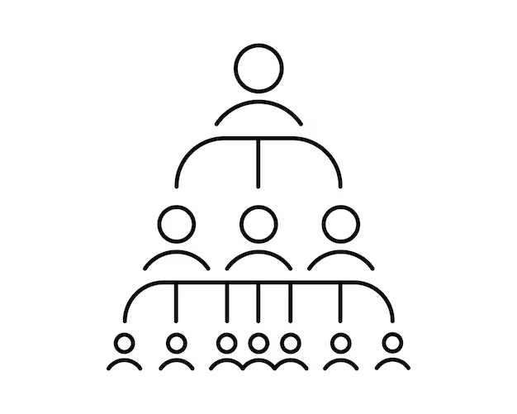
① List the projects core abilities or technical elements
Characterize them based on their functions and properties. Describe them in a general manner, independent from your (envisioned) product.
② Identify your market opportunities
Which applications can you offer with your core abilities? Which customers may need them? Zoom in to further segment each customer group.
Applications
Customers

Slide 3
STEP 1: MARKET OPPORTUNITY SET
Use the first worksheet to identify potential market opportunities and place them in the set

Slide 4
③ Market Opportunity:
POTENTIAL
CHALLENGE
LOW
MIDDLE
HIGH
SUPER HIGH
LOW
MIDDLE
HIGH
SUPER HIGH
COMPELLING REASON TO BUY
Unmet need
Effective solution
Better than current solutions
IMPLEMENTATION OBSTACLES
Product development difficulties
Sales and distribution difficulties
Funding challenges
LOW
MIDDLE
HIGH
SUPER HIGH
LOW
MIDDLE
HIGH
SUPER HIGH
MARKET VOLUME
Current market size
Expected growth
TIME TO REVENUE
Development time
Time between product and market readiness
Length of sale cycle
LOW
MIDDLE
HIGH
SUPER HIGH
LOW
MIDDLE
HIGH
SUPER HIGH
ECONOMIC VIABILITY
Margins (value vs. cost)
Customers’ ability to pay
Customer stickiness
EXTERNAL RISKS
Competitive threat
3rd party dependencies
Barriers to adoption
OVERALL POTENTIAL
CHALLENGE
LOW
MIDDLE
HIGH
SUPER HIGH
LOW
MIDDLE
HIGH
SUPER HIGH

Slide 5
STEP 2: ATTRACTIVENESS MAP
Use the second worksheets to evaluate the attractiveness of each market opportunity and place each one on the map
GOLD MINE
MOONSHOT
POTENTIAL
LOW MID HIGH SUPER HIGH
QUICK WIN
QUESTIONABLE
LOW MID HIGH SUPER HIGH
CHALLENGE

Slide 6
Customer profile
WHAT DO I OFFER?
Working towards the definition of the value proposition

Slide 7
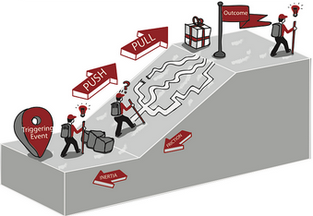
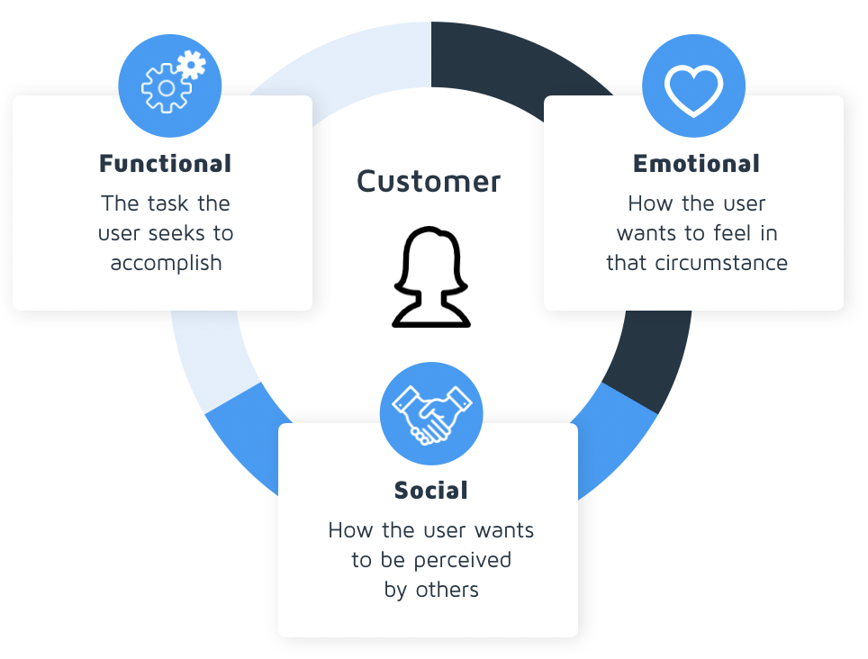
CONTEXT AND SITUATION
Key properties of the context for the job to be done
Specific situation
Include when, if relevant
PROBLEMS AND PAINS
Anything that prevent the customer from getting a job done:
- Negative emotions
- Undesired situations
- Costs and risks.
Include the problem severity level
ALTERNATIVES
Alternative solutions
Competitors
Substitutes
CRITERIA
(Minimum) criteria of your customer
The must-haves
DESIRED OUTCOMES
Outcomes that customer is looking for.
What does the customer’s life look like when problem is solved, and job is done?
Include metrics where possible.
DESIRES AND GAINS
Things that delight your customer.
Unexpected benefits
TRIGGERING EVENTS
Triggers that create a desire for better:
Bad experience
Change in environment
Awareness
JOBS TO BE DONE
FRICTION
Anything that creates uncertainty when trying a new solution
Includes new habits that need to be formed
INERTIA
Everything that keeps customers from trying new solutions. The status-quo/Habits/Switching costs

Slide 8
Value proposition
PRODUCTS AND SERVICES
List products & services
Fulfill functional, social, emotional and related jobs
Important features can be included
BENEFITS AND VALUE
Benefits:
The direct result of features (the promise). The things the customer can
accomplish because of the features of your product
Value:
- This is what drives customers to make buying decisions
- Often unique to each customer
- WHY your product is important to your customer
ALSO What’s in it for me?
Answer: Because of this (feature/benefit), …
Differentiation
Brochure headline
Short headline for your brochure or webiste
Highlights
What you do
The benefit / value
Think: Last sentence of your pitch

Slide 9
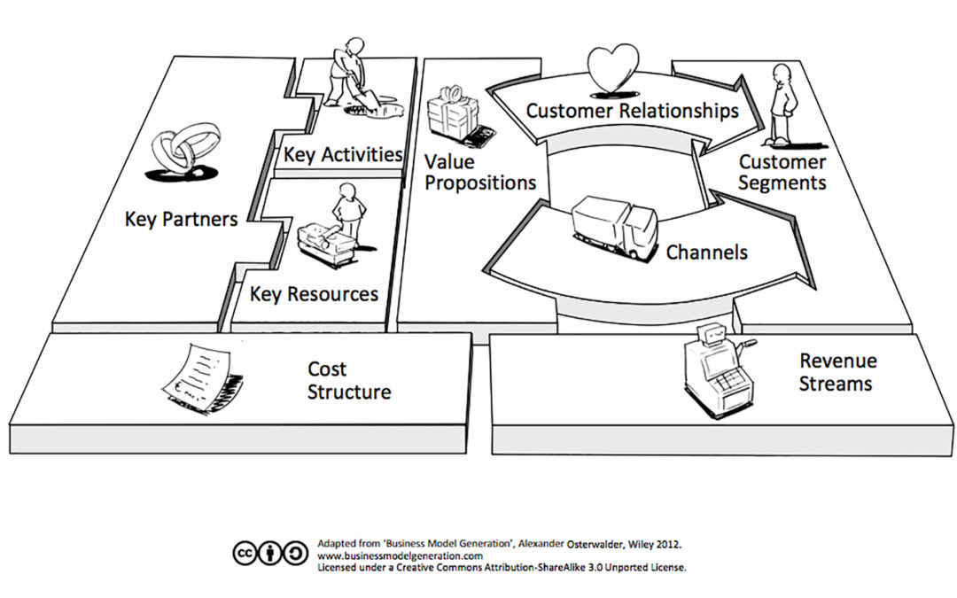
Business Model Canvas
HOW DO I OPERATE?

Slide 10
Prepare your Pitch
HOW DO I CONVEY THE MESSAGE?

Slide 11
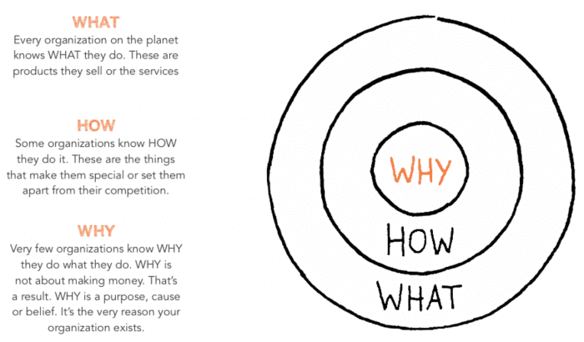
Simon Sinek’s Golden Circle

Slide 12
The Pitch Canvas
❶
Simple statement of what change you and your product are making in the world
❸
Product Not dominating the pitch!
❷
What problem are you solving for your customers?
What does your product do for customers?
How does it work?
❹
Live Demo?
Screenshot?
Physical product?
Product demonstration
❺
Show you have researched the market / the competition
Success so far
Pilot customers
Customer quotes …
❻
Customer traction

Slide 13
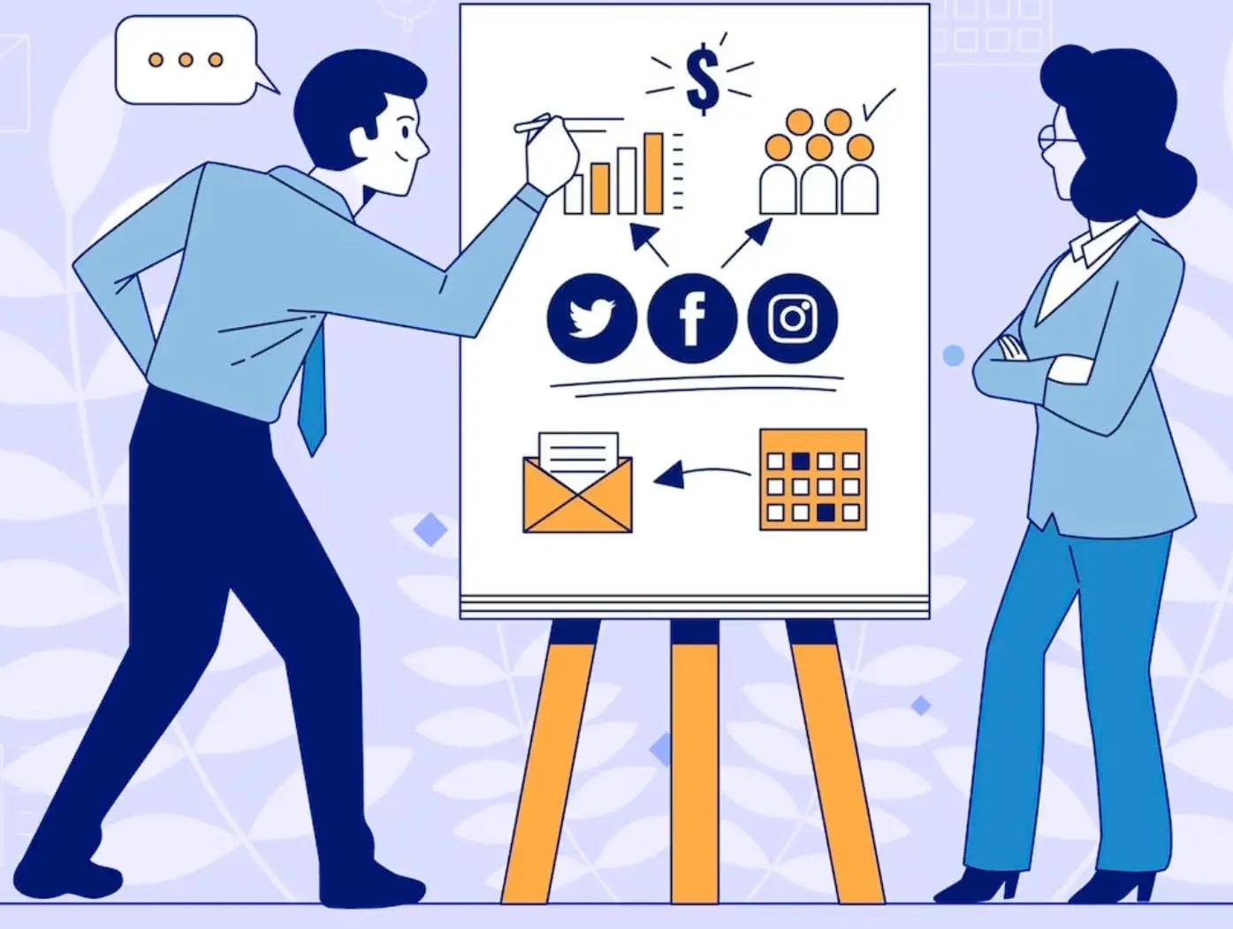
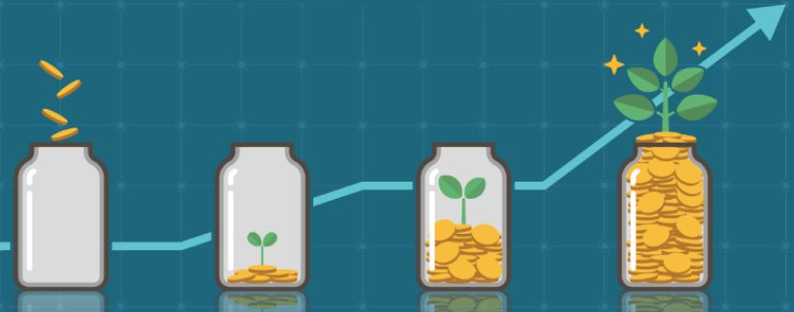
The Pitch Canvas
❼
How do you get paid?
Growth opportunity?
Scaling?
Business Model
How much are you looking for?
How many and what type of investors?
What will you use the investment for?
Milestones?
❽
Investments
❾
Your team experience goes here
Team
❾
End statement /
Call to action
Finish strong!
AND FOR ALL THIS YOU HAVE ………. 5 MINUTES!

